Slide 1
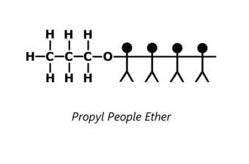

Slide 2
A1 Chemistry
Carbon Chemistry: Alkenes

Slide 3
Review
Carbon is pretty freakin’ awesome
Alkanes have only single bonds in their carbon chains and are named according to the length of the longest carbon chain.
Alkanes can have ‘alkyl’ side chains, like methyl and ethyl; these are added as prefixes, with words like di- and tri- to indicate how many, and numbers to show their location on the carbon chain IF NECESSARY; these are prioritised both in numbering and naming alphabetically.

Slide 4
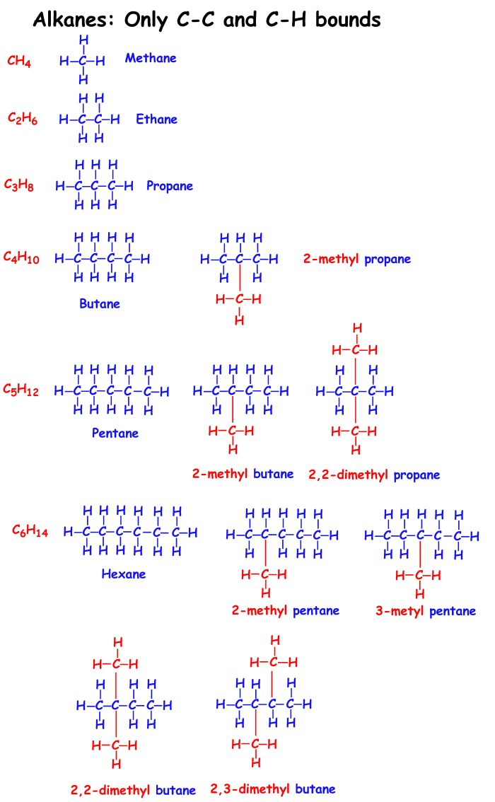
Review of alkanes
Name these:

Slide 6
Draw these:
3,4 – di methyl octane
3,3 – diethyl – 6 – methyl propyl heptane
diethyl pentane
2,2,3 – trimethyl hexane

Slide 7
Learning Intentions
hydrocarbons, including alkanes, alkenes and benzene, have different chemical properties that are determined by the nature of the bonding within the molecules
IUPAC nomenclature is used to name straight and simple branched alkanes and alkenes from C1- C8
alkanes, alkenes and benzene undergo characteristic reactions such as combustion, addition reactions for alkenes and substitution reactions for alkanes and benzene

Slide 8
Success criteria
Write general formula for alkenes CnH2n
Name alkenes
Draw alkenes

Slide 9
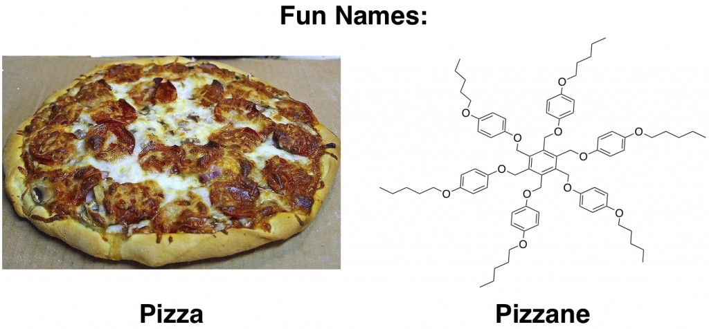

Slide 10
Key words
Alkene
Saturated and unsaturated

Slide 11
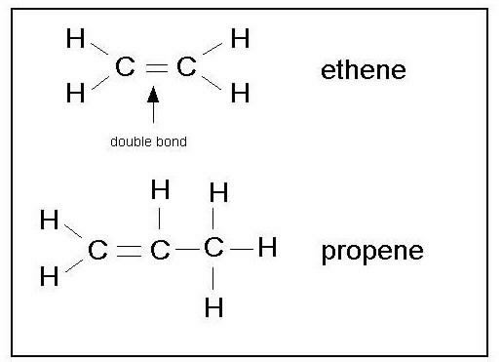
Alkenes
Contain one double bond between carbon

Slide 12
General formula
C_{n}H_{2n}
Alkenes are unsaturated, because they have less than “full” amount of hydrogens

Slide 13
Location of double bond
Number the chain so that the double bond is allocated the lowest number.
If there is more than one place the double bond could be, the name includes the number of the carbon it attaches to

Slide 14
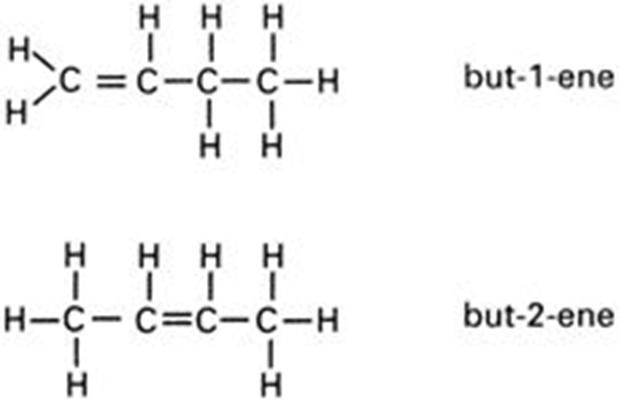

Slide 15
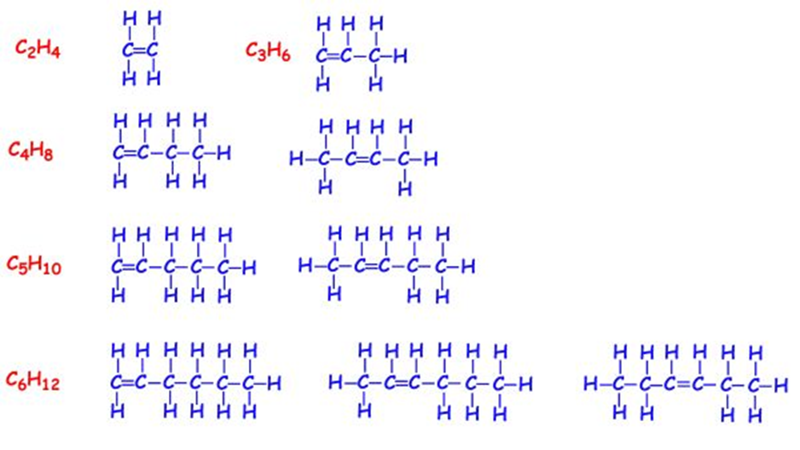

Slide 16
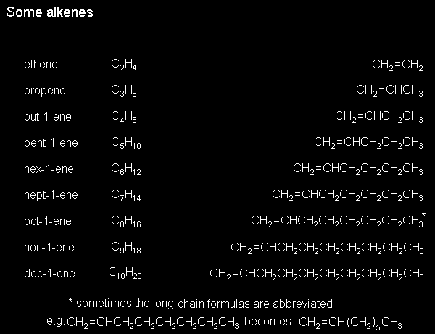

Slide 18
Side chains
Side chains have a lower priority than double bonds
After that, all side chain rules are as for alkanes,
ie alphabetical rank; di- tri- tetra- etc to indicate number of sidechains and number to indicate location IF there is more than one location they could be.

Slide 19
Name these

Slide 20
Draw these
propene
hept-2-ene
but-1-ene
hex-3-ene

Slide 21
Success criteria
Write general formula for alkenes CnH2n
Name alkenes
Draw alkenes

